Slide 1

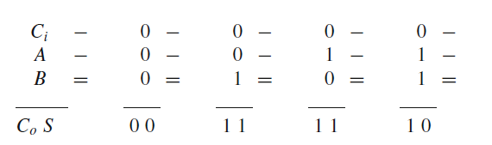
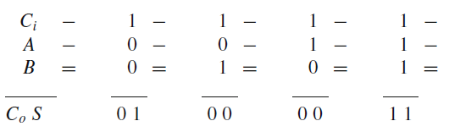
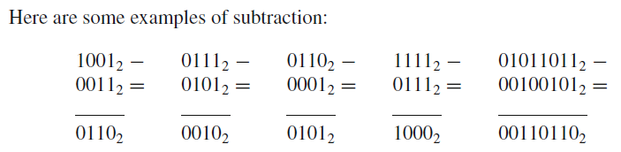
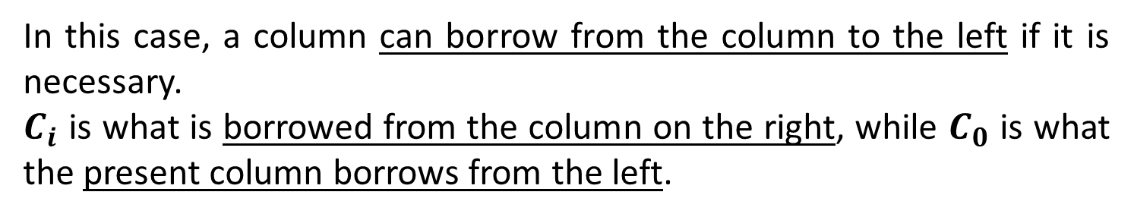
In this case, a column can borrow from the column to the left if it is necessary.
$C_{i}$ is what is borrowed from the column on the right, while $C_{0}$ is what the present column borrows from the left.

Slide 2
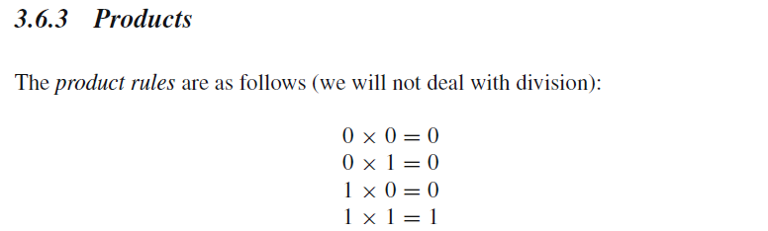
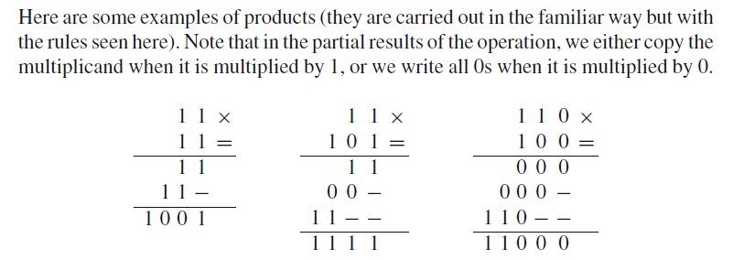

Slide 3
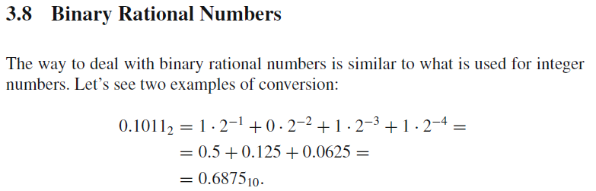

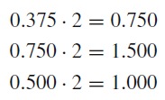
The integer part constitutes the binary number, and the decimal part is multiplied again by 2. Continuing:

Slide 4


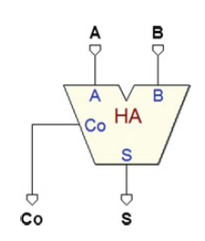
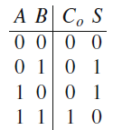
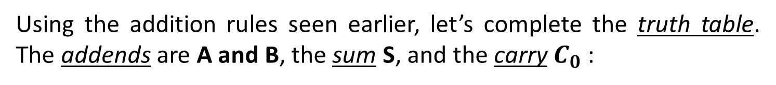
Half adders add two single-digit binary numbers generating: a result and a carry.
Using the addition rules seen earlier, let’s complete the truth table. The addends are A and B, the sum S, and the carry $C_{0}$:

Slide 5

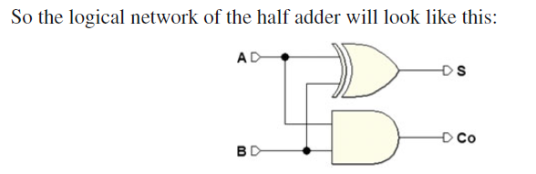

Slide 6

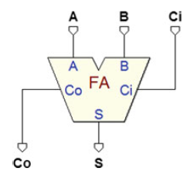
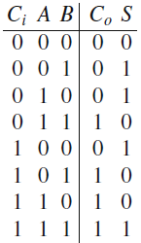
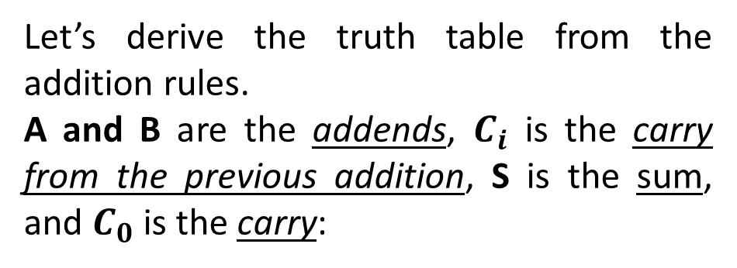
Full adders extend the possibilities of half adders by adding the carry from the preceding sum to the input.
Let’s derive the truth table from the addition rules.
A and B are the addends, $C_{i}$ is the carry from the previous addition, S is the sum, and $C_{0}$ is the carry:

Slide 7
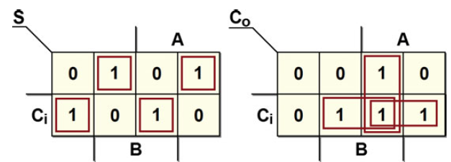
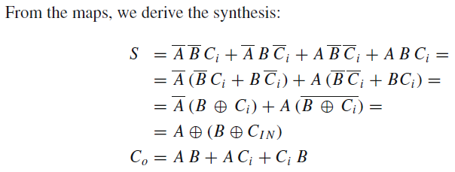

Slide 8
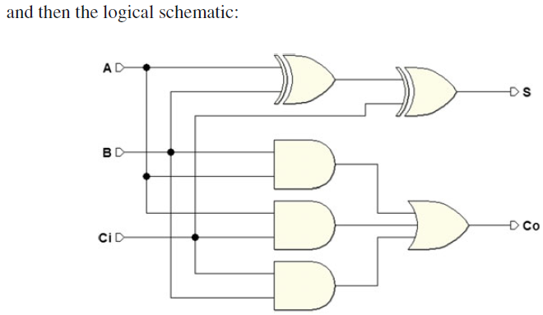

Slide 9

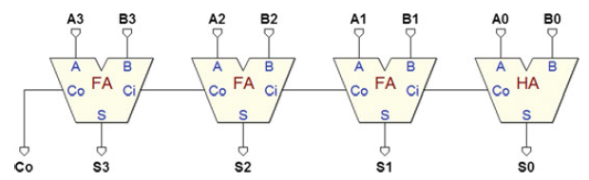

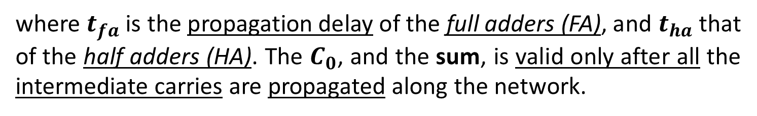
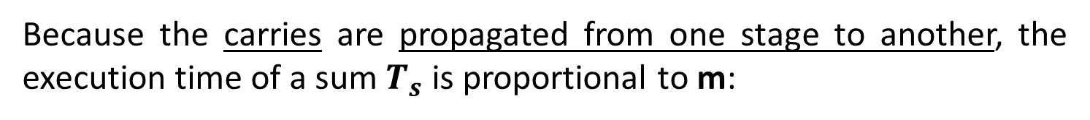
Ripple carry adder below allows us to calculate the sum of two 4-bit numbers, and it is extendable to any number with m bits:
Because the carries are propagated from one stage to another, the execution time of a sum $T_{s}$ is proportional to m:
where $t_{fa}$ is the propagation delay of the full adders (FA), and $t_{ha}$ that of the half adders (HA). The $C_{0}$, and the sum, is valid only after all the intermediate carries are propagated along the network.

Slide 10
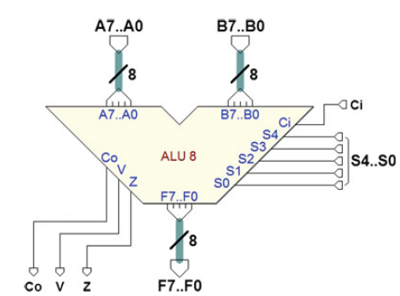
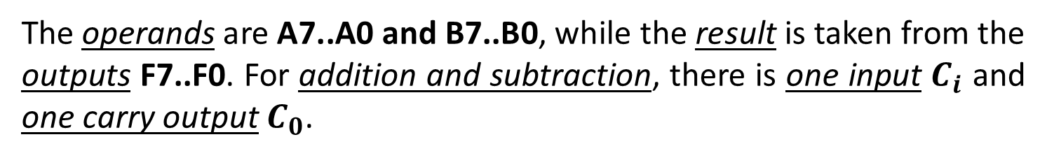
The ALU is a combinational network that makes it possible to do different operations on two binary numbers (A and B). The figure below shows an example of an 8-bit ALU
The operands are A7..A0 and B7..B0, while the result is taken from the outputs F7..F0. For addition and subtraction, there is one input $C_{i}$ and one carry output $C_{0}$.

Slide 11
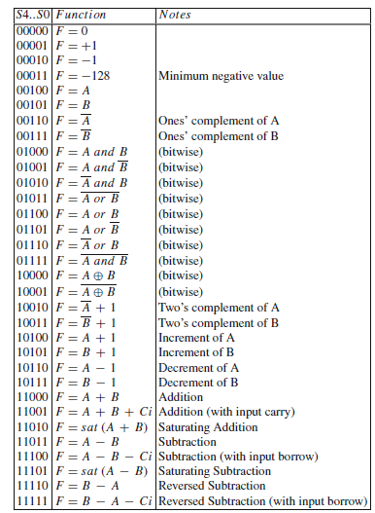
Outputs V and Z are also available: V = 1 shows that the arithmetic operation gave rise to an overflow, while Z = 1 is activated when the result of the operation is zero. The operations are selected by the group of inputs S4..S0, according to the table below:

Slide 12
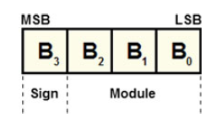
There are many methods to represent signed numbers in binary.
Rules for positive numbers will change to manage the operations involving negative numbers.
Let’s consider a 4-bit packet: we use the MSB for the sign bit and the rest for the module:
We code the sign minus with 1 and the sign plus with 0.

Slide 13
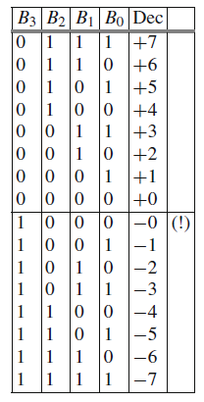
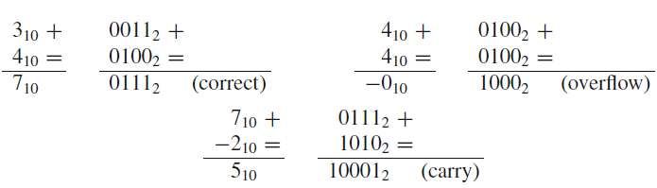
We code the sign minus with 1 and the sign plus with 0. We get the following table:
There are some downsides to this representation:
The zero has two different codes: 0000 and 1000.
The code has bad arithmetic properties.
As shown in the following examples, we cannot use a normal adder.
So, in a sign representation, we would need to use a more complex, tailor-made adder.

Slide 14

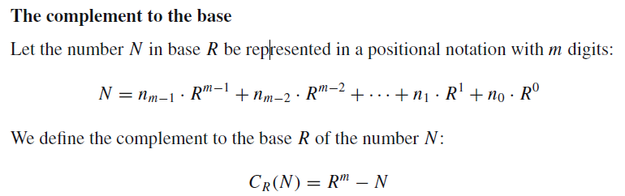
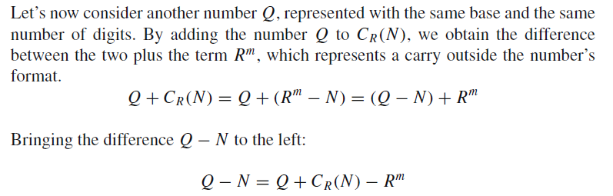

Slide 15
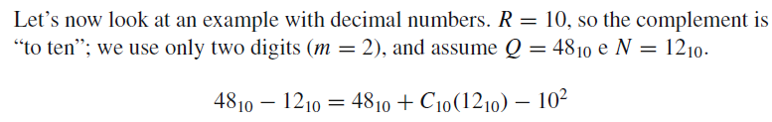





Slide 16
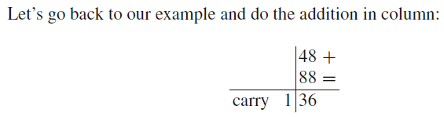
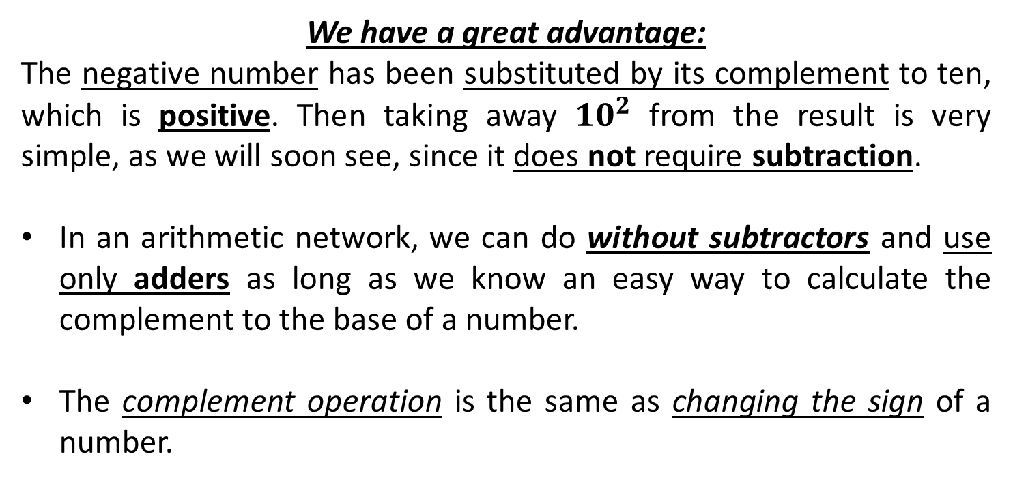
We have a great advantage:
The negative number has been substituted by its complement to ten, which is positive. Then taking away ${10}^{2}$ from the result is very simple, as we will soon see, since it does not require subtraction.
In an arithmetic network, we can do without subtractors and use only adders as long as we know an easy way to calculate the complement to the base of a number.
The complement operation is the same as changing the sign of a number.

Slide 17
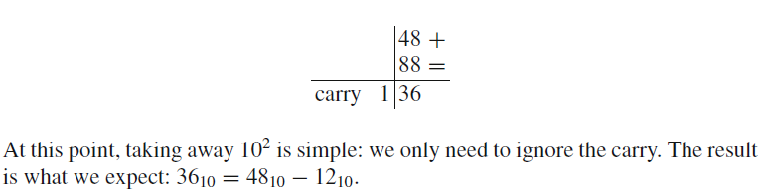
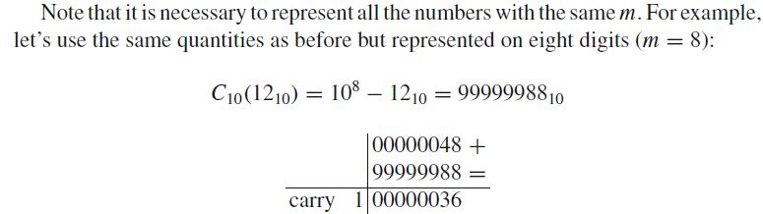

Slide 18
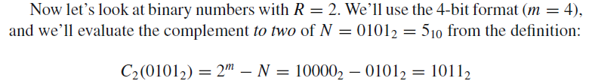



Slide 19
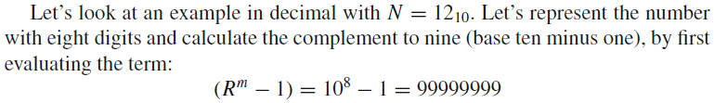
Calculating the complement to the base minus one is simpler than calculating the complement to the base.
Therefore, to obtain the complement to the base:
we prefer to calculate the complement to the base minus one and then add 1.
It is simpler to calculate the complement to nine because when we subtract the number we never need to borrow. Then, by adding 1 to the result, we get the complement to ten.

Slide 20
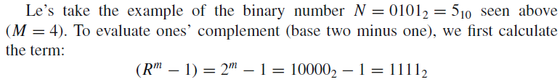

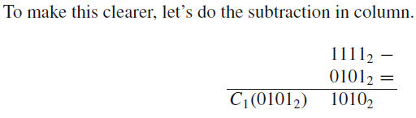
When we subtract the number from a number made only of “1”, there
is no need to borrow. To calculate the result, all we need to do is replace all the “1” with “0” and vice versa.

Slide 21


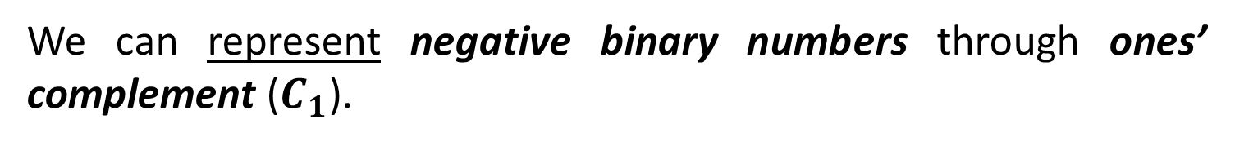
This means negating all the bits, the number N is composed of:
By adding +1 to the number obtained, we get the two’s complement:
We can represent negative binary numbers through ones’ complement ($C_{1}$).

Slide 22
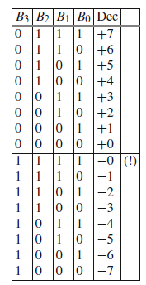

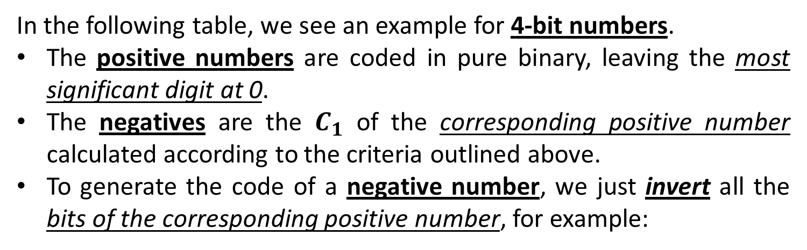
In the following table, we see an example for 4-bit numbers.
The positive numbers are coded in pure binary, leaving the most significant digit at 0.
The negatives are the $C_{1}$ of the corresponding positive number calculated according to the criteria outlined above.
To generate the code of a negative number, we just invert all the bits of the corresponding positive number, for example:

Slide 23


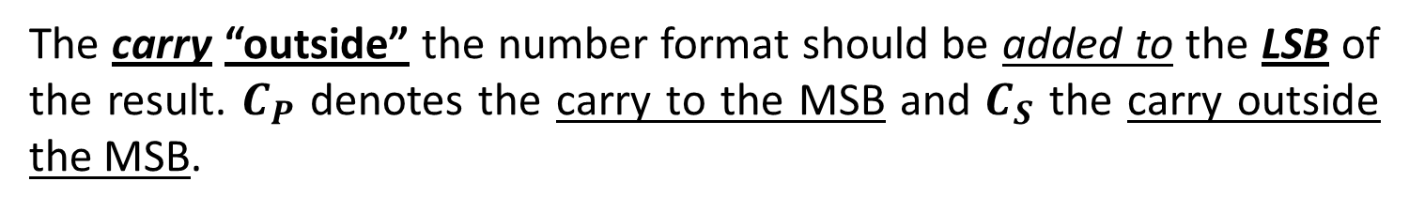
The carry “outside” the number format should be added to the LSB of the result. $C_{P}$ denotes the carry to the MSB and $C_{S}$ the carry outside the MSB.

Slide 24
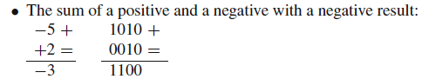

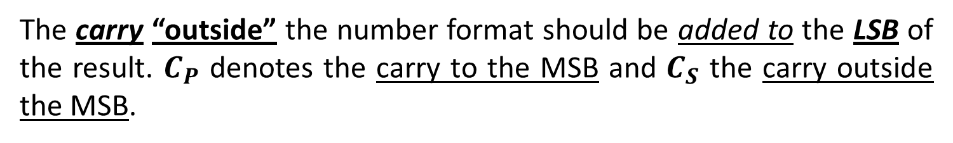
The carry “outside” the number format should be added to the LSB of the result. $C_{P}$ denotes the carry to the MSB and $C_{S}$ the carry outside the MSB.

Slide 25
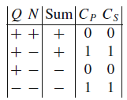

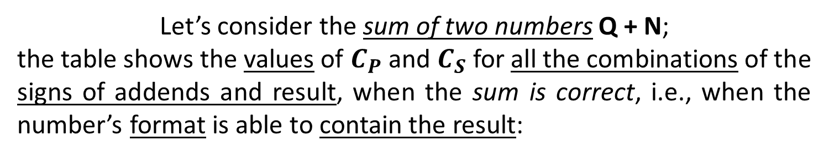
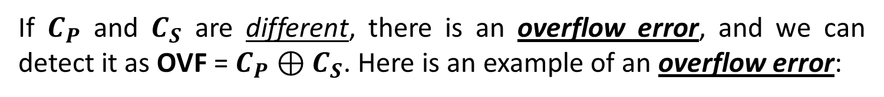
Let’s consider the sum of two numbers Q + N;
the table shows the values of $C_{P}$ and $C_{S}$ for all the combinations of the signs of addends and result, when the sum is correct, i.e., when the number’s format is able to contain the result:
If $C_{P}$ and $C_{S}$ are different, there is an overflow error, and we can detect it as OVF = $C_{P}⊕C_{S}$. Here is an example of an overflow error:

Slide 26
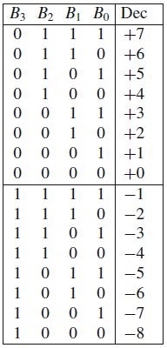
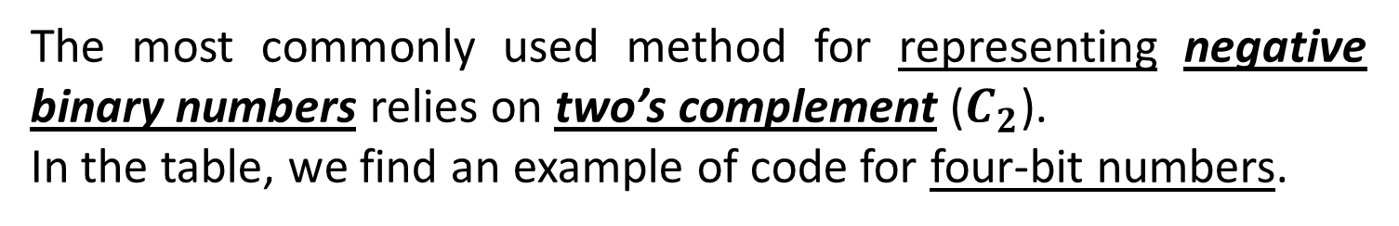
The most commonly used method for representing negative binary numbers relies on two’s complement ($C_{2}$).
In the table, we find an example of code for four-bit numbers.
The positive numbers here are coded in pure binary as before, leaving the most significant digit at 0,
while the negative numbers are calculated as two’s complement of the corresponding positive number.

Slide 27
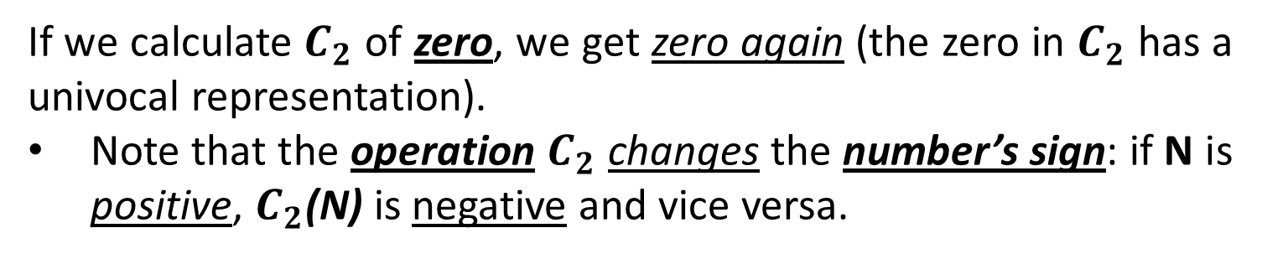
If we calculate $C_{2}$ of zero, we get zero again (the zero in $C_{2}$ has a univocal representation).
Note that the operation $C_{2}$ changes the number’s sign: if N is positive, $C_{2}$(N) is negative and vice versa.

Slide 28


Let’s look again at the carry into the MSB ($C_{P}$) and the carry outside the number ($C_{S}$). The same considerations for representation in $C_{1}$ also hold for $C_{2}$. When adding two numbers Q and N, the table used for checking the carries for overflow errors still holds:

Slide 29

As before, there is overflow when $C_{P}$ and $C_{S}$ are different:
OVF = $C_{P}⊕C_{S}$
$C_{2}$ code allows us to execute additions regardless of the sign of the addends by using a normal binary adder with no need to make corrections to the result (unlike with $C_{1}$ ).

Slide 30




A signed binary number represented in $C_{2}$ code (or in $C_{1}$), over m bits, can be extended to a larger number of bits v > m, provided that the sign and value are preserved.
Let’s consider a positive number, for example 610, represented on four
bits and its corresponding negative in $C_{2}$:
Let’s examine the positive number and consider the sign as an integral part of the number. In positional notation, it is:

Slide 31
If we represent it with 8 bits, the positional notation will be:
We have actually added non-significant zeroes to the left of the number.
Still, this method cannot work for negative numbers, first of all because we will change the sign to positive but also because we will also change the value.

Slide 32

As we can see, to extend a negative number to a larger number of bits, we only need to add 1s (rather than 0s) to the left.
In other words, we must add digits with a value equal to the sign on the left. From a circuital perspective, the extension of the sign is translated into a very simple network.

